Slide 1
HADOOP DISTRIBUTED FILE SYSTEM (HDFS)
The Hadoop Distributed File system(HDFS) is the Hadoop implementation of distributed file system design that hold large amount of data.
It provide easier access to stored data to many clients distributed across the network.
It is highly fault tolerant and designed to be run - on low - cost hardware (called commodity hardware).
The files in HDF Sarestored across the multiple machine inredundantfashion to recover the datalossincaseoffailure.

Slide 2
The HDFS file composed of fixedsize blocks or chunks that are stored on data nodes.
The name node is responsible for storing the metadata about each file that includes attributes of files like type of file, size, date and time of creation, properties of the files as well as the mapping of blocks to files at the data nodes.
The data node treats each data block as a separate file and propagates the critical information with the name node.

Slide 3
The significant benefits provided by HDFS are given as follows:
It provide streaming access to file system data
It is suitable for distributed storage and processing
It is optimized to support high streaming read operations with limited set.
It supports file operations like
Read ,write,delete but append not update.

Slide 4
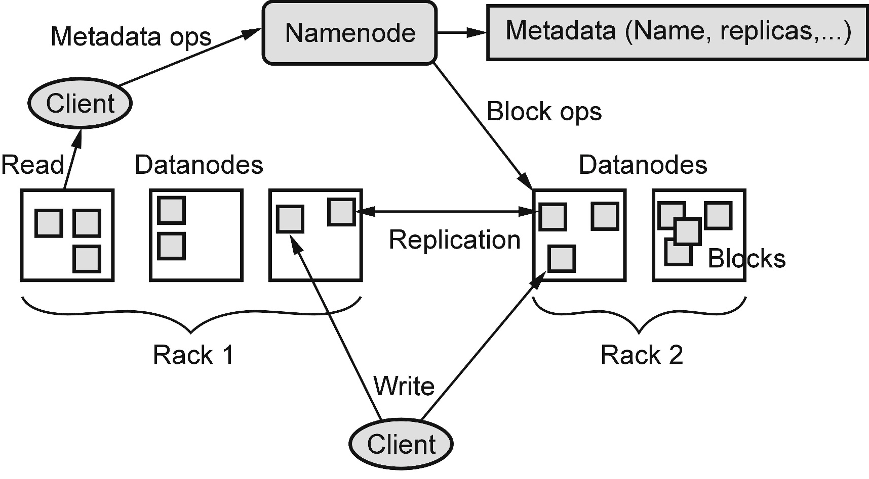
ARCHITECTURE OF HDFS

Slide 5
The HDFS follows Master-slave architecture using name node and data nodes.
The name node act as a master while multiple data nodes worked as slaves.
The HDFS is implemented as block structure file system where files are broken in to block of fixed size stored on Hadoop clusters
The Components of HDFS composed of following elements
Name Node
Data Node
HDFS Client
HDFS Blocks

